Slide 1
Finishing up Resampling
Class # 19
October 23, 2018

Slide 2
Announcements
HW8 posted, due next Tuesday.
There will be time to work on it in the next lab
HW9 will post next Monday
There may be time to work on it in the next lab
Guest lectures / panels upcoming
Nov 1! Career panel on data science in Energy, Development and (possibly) EJ
Reading:
Last lecture: ISLR 5.1
This lecture and next lecture: ISLR 5.2, ISLR 6.1, 6.2
Next lecture: Nychka and Saltzman (I will post reading questions today).

Slide 3
Resampling
What you can do with resampling:
Model assessment
Model selection
Measuring the accuracy of parameter estimates
Parameters can be model coefficients
But they can also be other quantities you’d like to compute with the model.
When you’ll (most likely) use which method:
Cross validation for model assessment and selection
Bootstrapping for measuring parameter accuracy

Slide 4
Summarizing cross-validation, part 1
In cross validation, we partition the data into k subsets of equal size
Each subset is n/k in size.
Then we fit a model k times
Each fit withholds one of the k partitions and trains the model on the remaining data
The withheld partition is used to compute a test error, MSE_{i}
The cross-validated error is:

Slide 5
Summarizing cross-validation, part 2
The cross-validated error is:
Then for each type of model you wish to evaluate, compare them on the basis of CV_{(k)}.
Choose the model type with the best CV_{(k)}.
Then the final model is the chosen model type fit to all the data

Slide 6
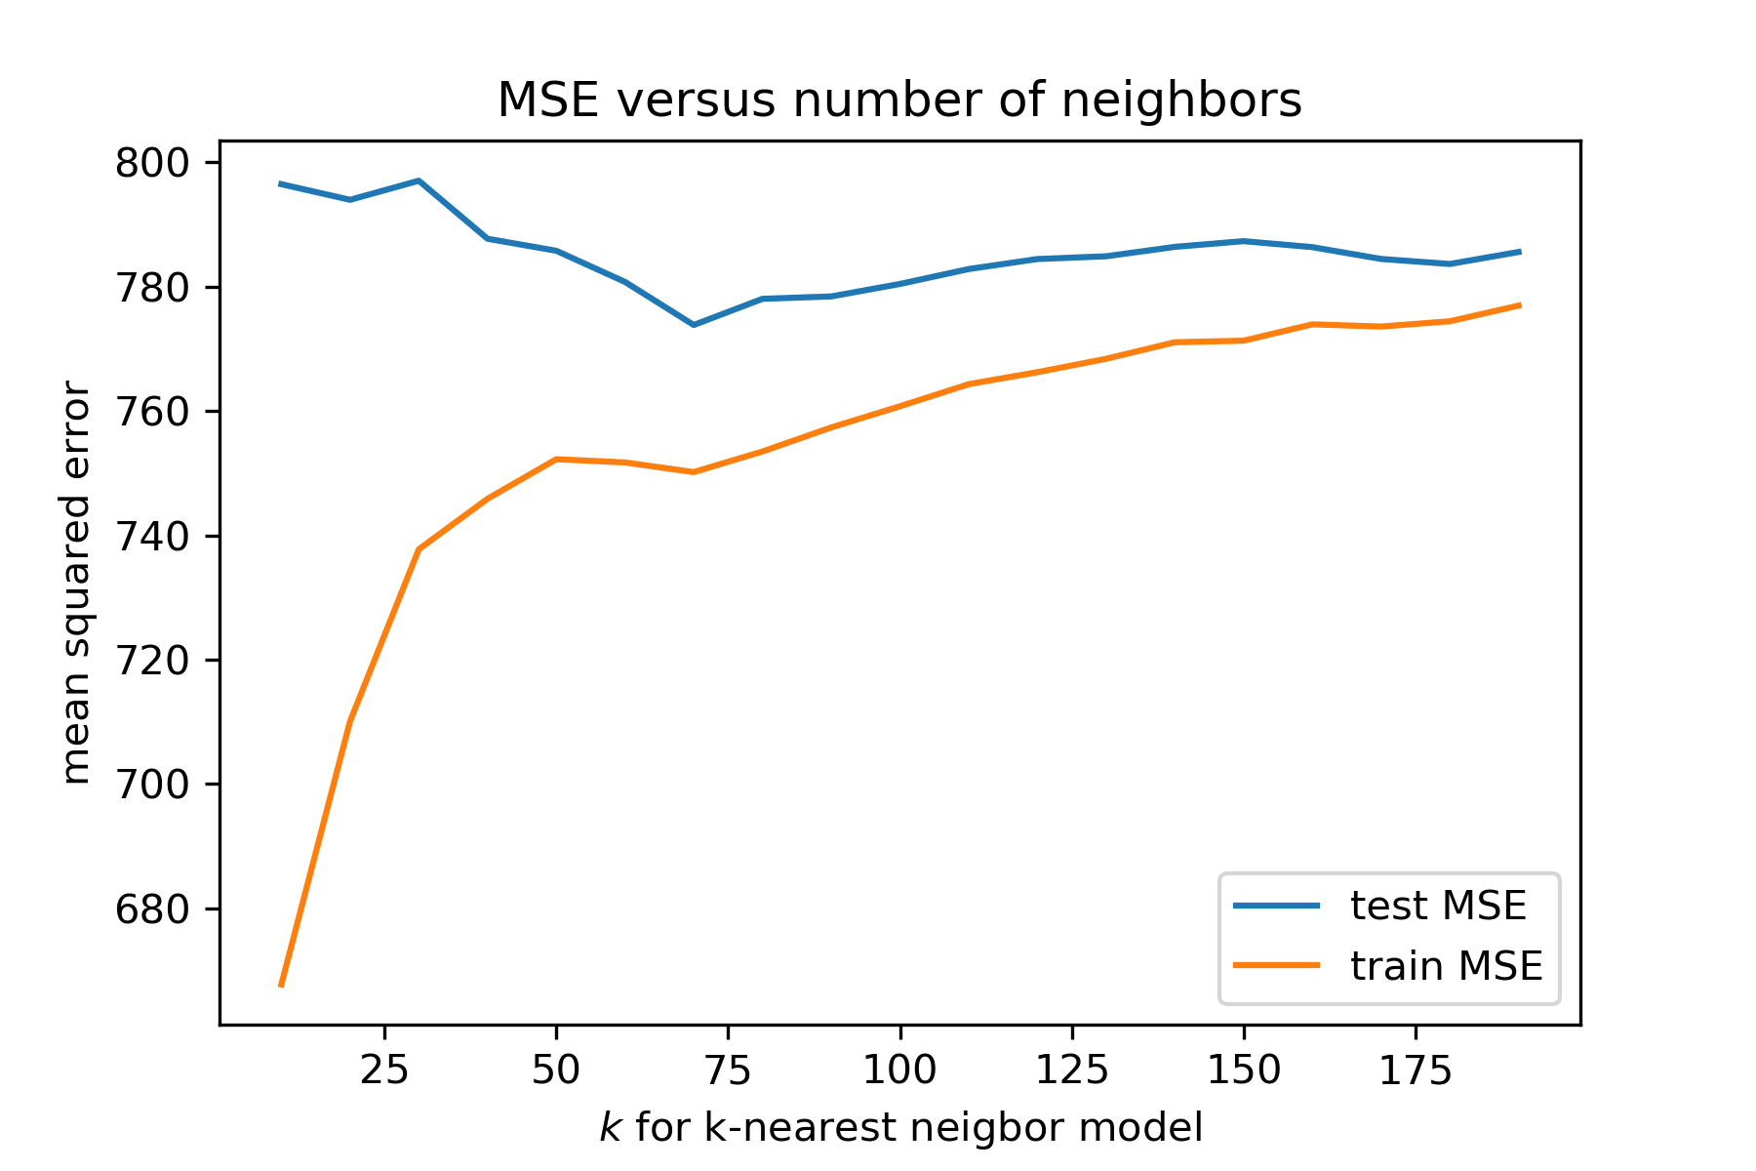
From Lecture 18 Jupyter Notebook

Slide 7
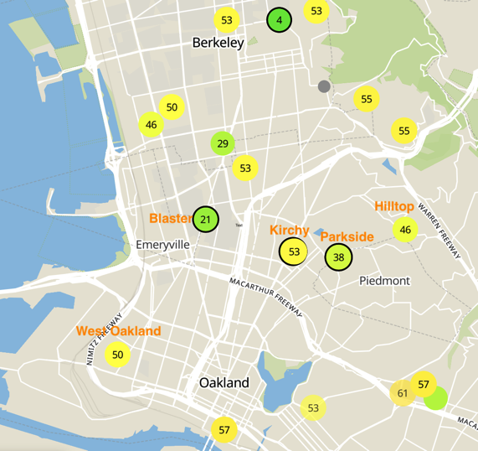
Indoor vs outdoor PM2.5

Slide 8
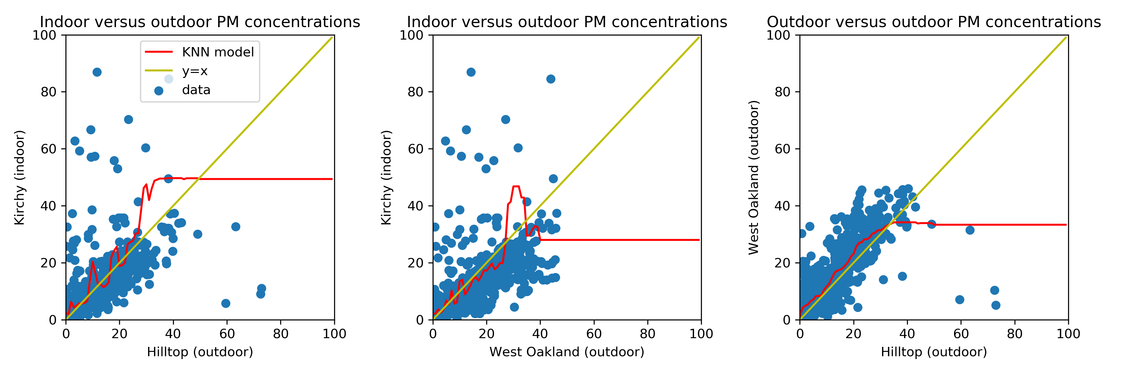
Exploring indoor vs outdoor concentrations

Slide 9
The Bootstrap
Standard error -- what is it?
A measure of the average difference between an estimate of a parameter from the true value of the parameter.
Standard errors can be computed with simple formulae in some cases, for example for coefficients fit using ordinary least squares (OLS) regression
However for many other cases there is no simple formula
When the assumptions required to apply the formulae don’t apply, even if you’re doing OLS
For example if your errors are strongly correlated
When you’re using a different algorithm to fit your model, for example linear discriminant analysis.

Slide 10
Computing the standard error numerically
If you can’t directly apply a formula to compute the standard error, you might be able to use your computer to construct the distribution
You could draw new sets of samples from your population repeatedly and recompute the parameter of interest
For example draw a set of N = 100 observations and repeat B = 1,000 times
The average parameter estimate across the B draws will be the true parameter, and you can measure the standard error from the distribution of parameter estimates
But! We can’t usually repeatedly sample from the true population
You can’t go out and re-survey a new set of 100 randomly chosen 1,000 times (or else you’ll never graduate!)

Slide 11
Enter the bootstrap
First key idea: create a new sample from your original sample by sampling with replacement.
Repeat this B times
Record the parameters you care about each time
The average parameter estimate will equal the true parameter
Second key idea: the standard error of the parameter estimate will be roughly the true standard error.

Slide 12
In other words…
Say it again: the standard error of the bootstrapped parameter estimates is a decent approximation of true standard error.
“The population is to the sample what the sample is to the bootstrapped sample”
How many in the sample? How many samples?
N = (Rule of thumb) Make your samples equal in size to the original sample
B = (Good practice) keep generating new samples until your estimates (parameter average and standard error) converge

Slide 13
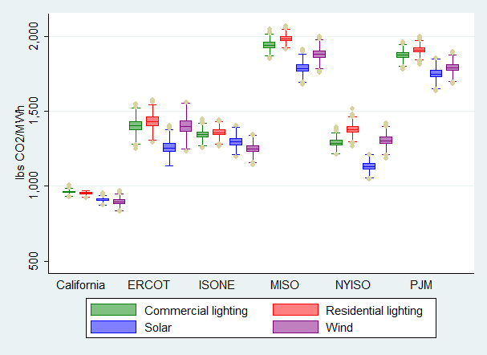
What can I bootstrap?
This is one of the advantages of bootstrapping: anything you might want to calculate from your data, you can bootstrap.
You don’t need to limit yourself to regression coefficients
Example: bootstrapped estimates of CO2 avoided by implementing various technologies in different locations (Callaway, Fowlie and McCormick, JAERE 2017)

